Slide 1
Slice- Based Testing

Slide 2
Informal definition of SBT
A program slice?
Refers to a set of program statements that may affect the computation of variable v at statement number (or node) n

Slide 3
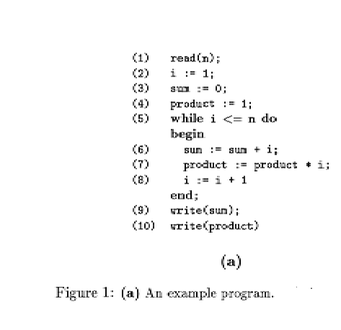
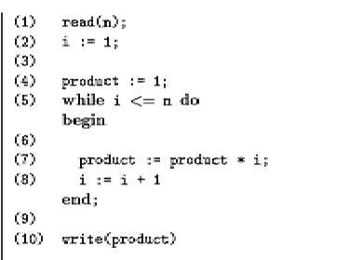

Example slice of the program w.r.t criterion(10, product)

Slide 4
Formal definition of Slice Based Testing
Given a program P, a program graph G(P) in which statements are numbered, and a set V of variables in P, the slice on the variable set V at statement n, S(V,n)
the set of node (or line) numbers of all statements fragments in P prior to n that contribute to the values of variables in V at statement fragment n

Slide 5
Slicing Criterion
Slicing criterion for a program specifies a window for observing its behavior
Where a window
specified as a statement and a set of variables
Allows the observations of values of the specified variables before execution of particular statement
E.g., S(x, 24) (i.e., value of x at line 24)

Slide 6
Example: The Commission problem in [Jorgenson02]
The Commission Problem Statement
Rifle salesperson in the Arizona Territory sold rifle locks, stocks, and barrels made by a gunsmith in Missouri. Locks cost $45.00, stocks cost $30.00, and barrels cost $25.00. Salespersons had to sell at least one complete rifle per month, and production limits are such that the most one salesperson could sell in one month is 70 locks, 80 stocks, 90 barrels. Each rifle salesperson sent a telegram to the Missouri company with the total order for each town s/he visits; salespersons visit at least one town per month, but travel difficulties made ten towns the upper limit. At the end of each month, the company computed commission as follows:
10% on sales up to $1000
15% on the next $800
20% on any sales in excess of $1800.
The company had four salespersons. The telegram from each salesperson were sorted into piles (by person) and at the end of each month a data file is prepared, containing the salesperson's name, followed by one line for each telegram order, showing the number of locks, stocks, and barrels in that order. At the end of the sales data lines, there is an entry of “-1” in the position where the number of locks would be to signal the end of input for that salesperson. The program produces a monthly sales report that gives the salesperson’s name, the total number of locks, stocks, and barrels sold, the salesperson's total dollar sales, and finally his/her commission.

Slide 7
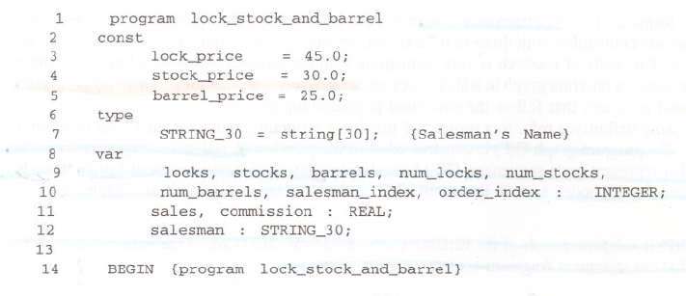

Slide 8
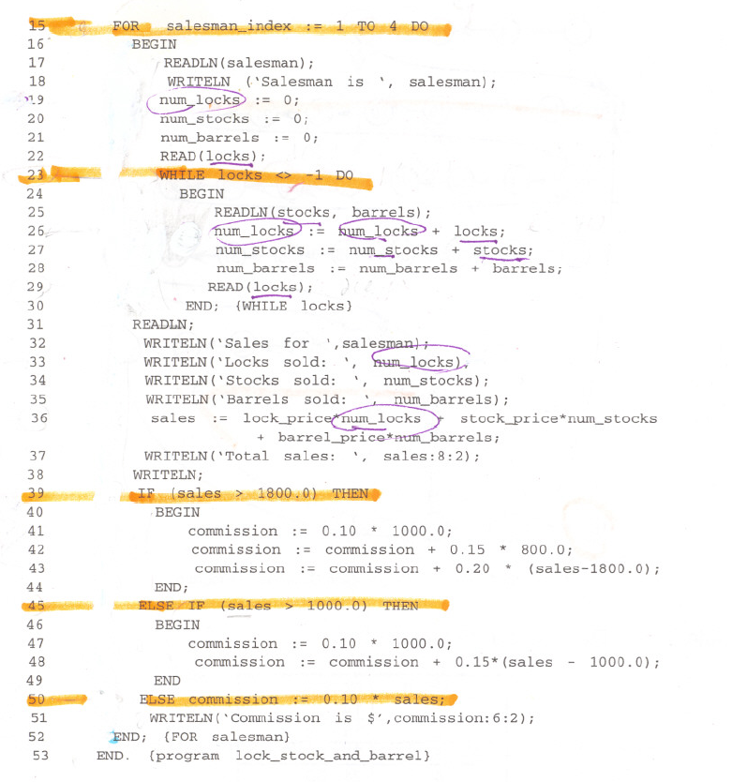

Slide 9
Lock has a predicate usage

Slide 10
Alternative definition: Program Slice
For statement n and variable v, the slice of program P w.r.t. the slicing criterion <n, v > includes only those statements of P needed to contribute (or influence) to the behavior of v at n.

Slide 11
Simple example
1 Y := X
2 Z := Y
The value of X before the first statement can contribute to the value of Z after second
S(Z,2)

Slide 12
The notion of contribution: USE
The notion of contribution can be described by the USE relationship (e.g., C-use and P-use)
P-use: used in a predicate (e.g., decision)
C-use: used in computation (e.g., assignment)
O-use: used for output (e.g., write/print, etc.)
L-use: used for location (e.g., pointers/subscripts)
I-use: used for iteration (e.g., internal counter)

Slide 13
The notion of contribution: Definitions
Definition nodes can be refined
I-def: defined by input (e.g., read)
A-def: defined by assignment statements (e.g., a:= x + y)

Slide 14
Properties of Slice
There are two properties in a slice
The slice must have been obtained from the original program by statement deletion.
The behavior of the slice must correspond to the behavior of program as observed through the window of the slicing criterion

Slide 15
Problem with property one
By removing the source code of a program, we may obtain slice that is not grammatically correct.
E.g. removing the THEN clause from an IF-THEN-ELSE block

Slide 16
simple guidelines
First, we assume the set V consists of a single variable
Nodes in slice S may include:
If statement (or node) n is a defining node for v, n is included in the slice S.
If statement n is a USE node for v, then n is not included.
P-Use and C-use of other variables (not the v in the slice set V) are included if their execution affects the value of v.

Slide 17



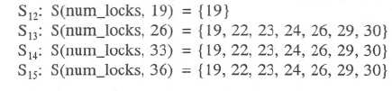
the Commission Problem (1)
loop

Slide 18
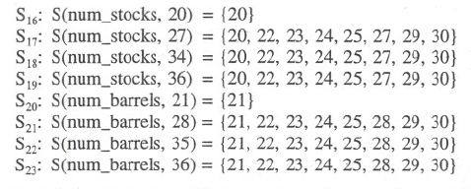

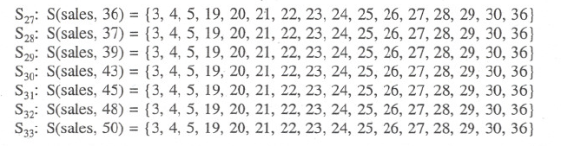
the Commission Problem (2)
Compiler defined

Slide 19
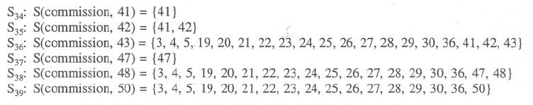
the Commission Problem (3)

Slide 20
Good rules of thumb for SBT
Never make a slice S(V,n) for which variables v ∈ V do not appear in statement fragment n
Make slices on one variable
Make slices for all A-def nodes
e.g.,
S₂₇:S(sales,36)={3,4,5,19,20,21,22,23,24,25,26,27,28,29,30,36}
Make slices for P-use node because the slice shows how the predicate variable gets its value
Stay away from non P-use slices
Consider making slices compile-able (executable)`

